Slide 1
Dr. Marjan Mahdavi-Roshan Assistance Professor in Nutrition Sciences, Guilan university of medical sciences
Diet therapy in Diabetes

Slide 2
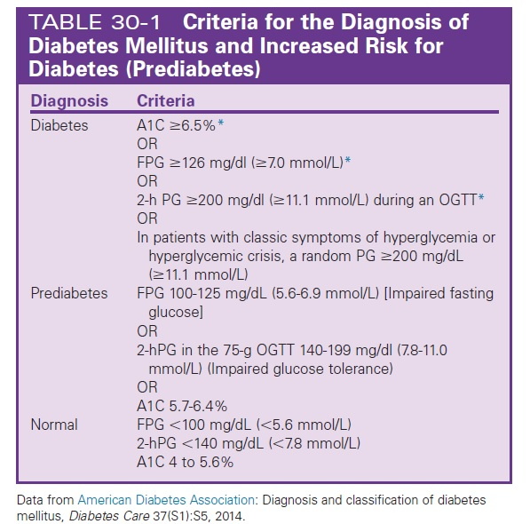

Slide 3
Medical Nutrition Therapy for Prediabetes
Use of the pharmacologic agents metformin, alpha-glucosidase inhibitors, orlistat, and thiazolidinediones has been shown to decrease incidence of diabetes by various .
At this time, metformin is the only drug that should be considered for use in diabetes prevention. It is the most effective in those with a BMI of at least 35 kg/m2 and who are under age 30.
For other drugs, issues of cost, side effects, and lack of persistence of effect are of concern.

Slide 4
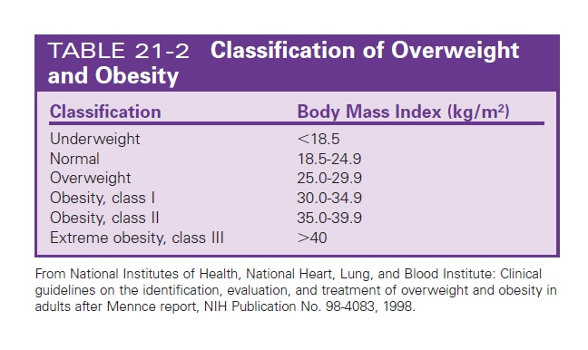
Weight loss and/or achievement of ideal body weight (body mass index [BMI] of 18.5 to 24.9 kg/m2) should be part of the medical treatment

Slide 5
Physical activity
Medical management must include lifestyle changes. Physical activity is important to prevent weight gain and maintain weight loss. For cardiovascular fitness and to reduce risk of T2DM,
Recommendations include:
moderate-intensity aerobic physical activity a minimum of 30 minutes 5 days per week (150 min/week)
vigorous-intensity aerobic physical activity a minimum of 20 minutes 3 days per week (90 min/week).
Muscle-strengthening activities involving all major muscle groups two or more days per week are also recommended

Slide 6
Physical activity independent of weight loss improves insulin sensitivity.

Slide 7
Goals of MNT for prediabetes emphasize the importance of
food choices that facilitate moderate weight loss.
Whole grains and dietary fiber are associated with reduced risk of diabetes.
Increased intake of whole grain–containing foods improves insulin sensitivity independent of body weight.
Increased intake of dietary fiber has been associated with improved insulin sensitivity and improved ability to secrete insulin adequately to overcome insulin resistance.

Slide 8
High consumption of sugar-sweetened beverages, which includes:
Soft drinks, fruit drinks, and energy and vitamin water type drinks containing sucrose, high-fructose corn syrup, and/ or fruit juice concentrates is associated with the development of T2DM

Slide 9
Studies also have reported that an eating pattern high in saturated fatty acids and trans fatty acids is associated with increased markers of insulin resistance and risk for type 2 diabetes, whereas unsaturated fatty acid intake is associated inversely with risk of diabetes .
lifestyle changes that include moderate weight loss with strategies including reduced calories and reduced intake of fat are effective.

Slide 10
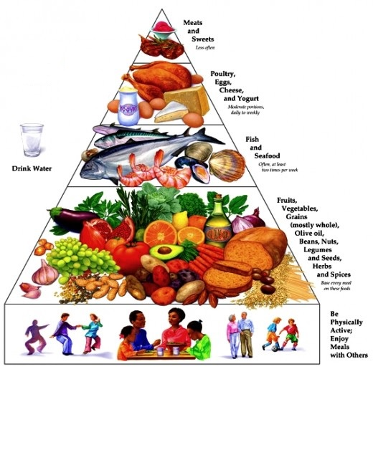
Adherence to Mediterranean-style eating pattern characterized by high levels of monounsaturated fatty acids such as olive oil, high intake of plant-based foods, moderate amounts of fish, and a low intake of red and processed meat and whole-fat dairy products versus low adherence has been associated with a lower incidence
of diabetes

Slide 11
Medical Nutrition Therapy for Diabetes

Slide 12
MNT implemented by dietitian reduced A1C levels by an average of 1% to 2% depending on the type and duration of diabetes and the A1C level at implementation These outcomes are similar or greater to those from glucose-lowering medications.
MNT also is reported to improve lipid profiles, decrease blood pressure, promote weight loss, decreased need for medications,and decrease risk of onset and progression to diabetes-related comorbidities

Slide 13
Energy Balance and Weight Management
Overweight and obesity are, however, common health problems in persons at risk for and with DM.
Weight loss frequently is recommended as the solution to improve glycemic control. (7-8% of baseline weight)

Slide 14
A variety of nutrition therapy interventions can be implemented. A unified focus of MNT:
For T2DM is a reduced energy intake
For T1DM is carbohydrate counting and insulin-to-carbohydrate ratios.

Slide 15
Carbohydrate Intake
There is the clear link between glycemic control and the development of complications in persons with T1DM and T2DM.
Evidence exists that the quantity and type of carbohydrate
eaten influence blood glucose levels; however, the total
amount of carbohydrate eaten is the primary predictor of glycemic response.

Slide 16
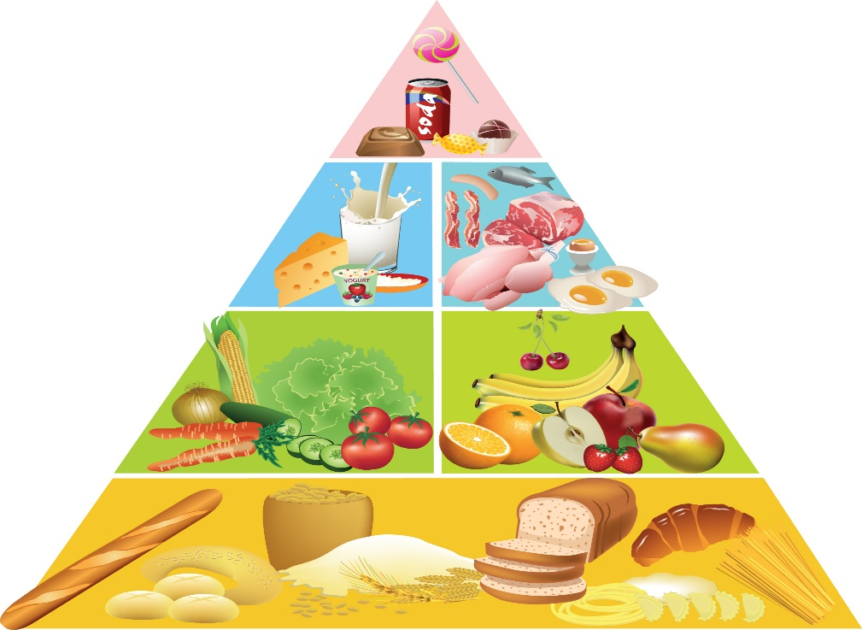
Carbohydrate foods include starches, such as breads, cereals, pasta, rice, starchy vegetables, crackers, and snack chips; fruits and fruit juices; milk, milk substitutes and yogurt; and sweets and desserts.
One carbohydrate choice or serving is a portion of food containing15 grams of carbohydrate.

Slide 17
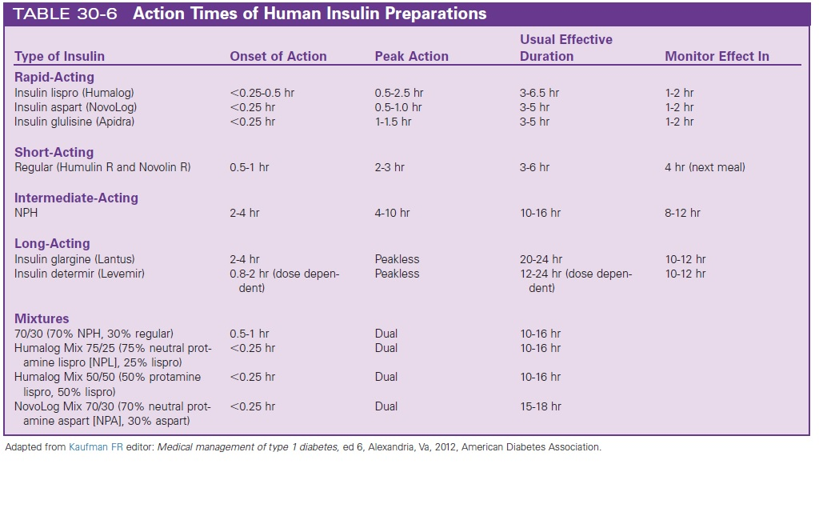

Slide 18
Fiber intake
Grams of fiber are calculated as having about half the energy (2kcal/g) of most other carbohydrates (4 kcal/g.).
However, for most people, it is not necessary to subtract the amount of dietary fiber (or sugar alcohols) when carbohydrate counting.
Consuming foods containing 25 g fiber per day for
adult women and 38 g per day for adult men is encouraged.

Slide 19
Non-nutritive and Hypocaloric Sweeteners
Reduced calorie sweeteners approved by (FDA) include
sugar alcohols (sorbitol,mannitol, xylitol, isomalt, lactitol,)
They produce a lower glycemic response and contain, on average, 2 calories per gram.
Saccharin, aspartame, neotame, acesulfame potassium,
and sucralose are non-nutritive sweeteners approved for use by the FDA.
For example, aspartame actual daily intake in persons with diabetes is 2 to 4 mg/kg of body weight daily
The stevia-derived sweetener, is generally recognized as safe.

Slide 20
The effect of MNT on A1C will be known by 6 weeks to 3 months, at which time the dietitian must assess whether the goals of therapy have been met by changes in lifestyle or whether changes or additional medications are needed

Slide 21
Vitamin or mineral supplements
No clear evidence has been established for benefits from vitamin or mineral supplements in persons with diabetes (compared with the general population) who do not have underlying deficiencies
Clinical trial data not only indicate the lack of benefit but also provide evidence of the potential harm.
Therefore routine supplementation is not advised.

Slide 22
It is important that people with diabetes receive medical care
from a team that may include physicians, dietitians, nurses,
pharmacists, and mental health professionals with expertise in
diabetes. Individuals with diabetes also must assume an active
role in their care.

Slide 23
Potential Problems with Exercise
Hypoglycemia is a potential problem associated with exercise in persons taking insulin or insulin secretagogues. Hypoglycemia has been reported to be more common after
exercise—especially exercise of long duration—strenuous activity or play, than it is during exercise. This is because of increased insulin sensitivity after exercise
Hyperglycemia also can result from exercise of high intensity, likely because the effects of counterregulatory hormones. When a person exercises at what for him or her is a high level of exercise intensity, there is a greater-than-normal increase in counterregulatory hormones. As a result, hepatic glucose release exceeds the rise in glucose use.

Slide 24
Exercise in diabetic people
In all persons, blood glucose levels decline gradually during exercise, and ingesting a carbohydrate feeding during prolonged exercise can improve performance by maintaining the availability and oxidation of blood glucose.
For the exerciser with diabetes whose blood glucose levels may drop sooner and lower than the exerciser without diabetes, ingesting carbohydrate after 40 to 60 minutes of exercise is important and also may assist in preventing hypoglycemia.

