Slide 1
Medical Nutrition Therapy in Gestational Diabetes Mellitus
Dr. Fatemeh Sedaghat
PhD in Nutrition Sciences
Faculty and Institute of Nutrition and Food Technology, Shahid Beheshti University of Medical Sciences

Slide 2
Definition & Worldwide Prevalence of GDM
GDM is defined as any degree of glucose
intolerance with onset or first recognition
during pregnancy
Approximately 7% of all pregnancies are complicated by GDM
ranging from 1 to 14% depending on
the population studied
the diagnostic tests
more than 200,000 cases annually
Diabetes care, 2009

Slide 3
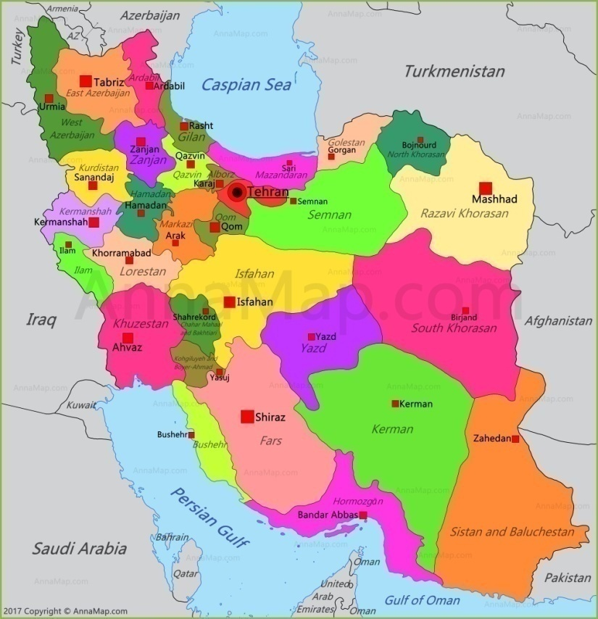
Prevalence of GDM in Iran
According to 14 studies from 1992-2007, the prevalence of GDM ranged between 1.3% to 10% in different regions of Iran.
Khoshniat, 2009

Slide 4
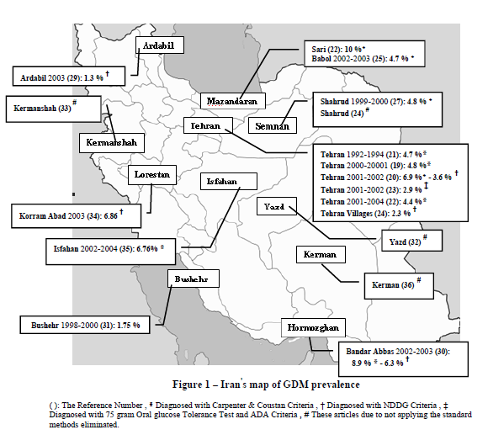
Khoshniat N, Iranian Journal of Diabetes and Lipid Disorders; 2009

Slide 5
Pathophysiology
In first trimester and early second trimester, increased insulin sensitivity occurs due to relatively higher levels of estrogen.
in late second and early third trimesters, increased insulin resistance and reduced sensitivity due to a number of antagonistic hormones especially, placental lactogen, leptin, progesterone, prolactin, cortisol and adiponectin.

Slide 6
Risk Factors for Development of GDM
Age >25years
• BMI >25kg/m²
• Increased weight gain during pregnancy
• Previous history of large for gestational age infants
• History of GDM during previous pregnancies
• Ethnic group ( East Asian, Pacific Island ancestry)
• Elevated fasting or random blood glucose levels during pregnancy
• Family history of diabetes in first degree relatives
• History of type I or type II Diabetes Mellitus
Cheung,2009

Slide 7
GDM Complication
Adverse Pregnancy Outcomes:
macrosomia
shoulder dystocia
Jaundice
polycythemia
respiratory distress
Hypocalcemia
Risk of developing diabetes later in life
Cheung,2009

Slide 8
GDM Complication
Maternal Complication :
Weight gain
Maternal hypertensive disorders
Miscarriages
Third trimester fetal deaths
Cesarean delivery (due fetal growth disorders)
Long term risk of type 2 diabetes mellitus
Cheung,2009

Slide 9
GDM Screening
Screening should be done during the 24th to 28th week of pregnancy using a 100-g oral glucose tolerance test (OGTT).
Fasting glucose of more than 92 mg/dL
I-hour glucose of more than 180 mg/dL
2-hour glucose of 153 mg/dL or more
3-hour glucose of 140 mg/dL or more

Slide 10
Maternal Dietary Patterns and GDM
The results of recent systematic reviews showed that adherence to a healthier dietary pattern, like Mediterranean dietary pattern, and reducing the intake of sugar sweetened cola, potatoes, fatty foods, sweets can decrease the incidence of GDM, especially in women at higher risk and before getting pregnant.
D. A. Schoenaker, 2016

Slide 11
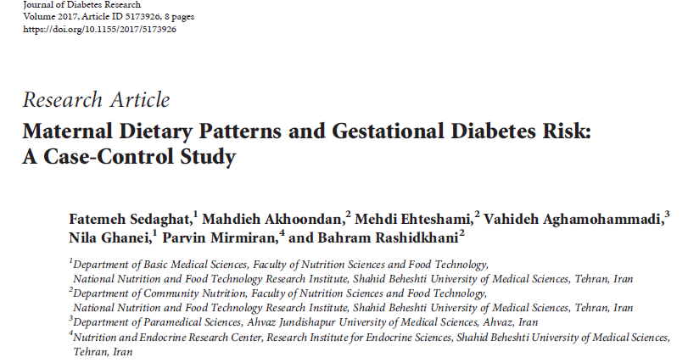
Western dietary pattern was high in sweets, jams, mayonnaise, soft drinks, salty snacks, solid fat, high-fat dairy products, potatoes, organ meat, red meat, processed foods. Western dietary pattern was associated with increased risk of GDM.
Notes:
A total of 388 pregnant women (122 case and 266 control)

Slide 12
Medical Nutrition Therapy (MNT) in GDM

Slide 13
Medical Nutrition Therapy (MNT)
The American Diabetes Association recommends that all women with GDM receive nutrition counseling by a registered dietitian (RD).
MNT is the primary therapy for 30 –90% of women diagnosed with GDM.
Individualization of MNT depending on maternal weight and height, physical activity level, and lifestyle is recommended.
Reader,2007

Slide 14
Medical Nutrition Therapy (cont’)
Goals:
Achieve normoglycemia
Recommended treatment targets
Test | Gestational Diabetes (mg/dl)
Fasting plasma glucose | 65-95
I hr postprandial | <140
2 hr postprandial | <120
ADA,2004

Slide 15
Medical Nutrition Therapy (cont’)
Goals:
Providing the required nutrients for normal fetal growth and maternal health.
Prevent excessive maternal weight gain, particularly in women who are overweight or have gained excess weight in pregnancy.
Prevent ketosis.

Slide 16
Medical Nutrition Therapy (cont’)
Include:
Nutrition therapy
Exercise
Self-monitoring of blood glucose (SMBG)
Pharmacologic therapy
Education

Slide 17
Nutrition Therapy

Slide 18
Efficacy of Dietary Therapy for GDM
Nutrition intervention for GDM has been recognized as the cornerstone of therapy.
In patients receive diet therapy:
Fewer patients require insulin therapy
Decrease HbA1c
lower serious perinatal complications among the infants:
lower perinatal mortality
lower % large-for-gestational-age
Less macrosomia
Crowther ,2005, Reader,2006, Cheung,2009

Slide 19
Nutrition Therapy (cont’)
All women should receive individualized counseling
Food plan should be individualized & culturally appropriate
to provide adequate calories & nutrients to meet
the needs of pregnancy and consistent with the blood glucose goals
Cheung,2009

Slide 20
Nutrition Therapy (cont’)
“Do the Institute of Medicine and other recommendations for weight gain and calorie intake apply to the woman with GDM?”
“Weight gain during pregnancy for women with GDM should be similar to that of women without diabetes”
Reader,2007

Slide 21
Nutrition Therapy (cont’)
weight-gain recommendations based on
prepregnancy BMI
(BMI (kg/m2 | weight-gain (kg)
Underweight ˂ 18.5 | 12-18
normal 18.5 –25.0 | 11.3 –15.3 kg
overweight 25–29.9 | 6.8–11.3 kg
Obese >29 | 7 kg
(Institute of Medicine’s Nutrition for Pregnancy 1990)

Slide 22
Nutrition Therapy (cont’)
Overweight and obese women:
Severe calorie restriction <1500 calories per day or 50% restriction increases ketonuria and ketonemia.
American Diabetes Association have suggested:
a 30–33% calorie restriction for obese women with GDM, noting a minimum 1800 calorie
ADA,2000
Notes:
, 1,600–1,800 or a 33% reduction in intake, does not lead to ketosis but controls weight gain and glucose levels in obese wome

Slide 23
Nutrition Therapy (cont’)
Calorie formulas have been suggested in articles and guidelines for GDM:
35–40 kcal/kg for underweight
30 –35 kcal/kg for normal weight
25–30 kcal/kg for overweight
23–25 kcal/kg (pregravid weight) for obese
Reader,2007

Slide 24
Nutrition Therapy (cont’)
Macronutrient Intake
Carbohydrate (CHO): 50 to 55% kcal intake
Protein: 20-25 % kcal intake
Fat: 25-30% kcal intake
Cheung,2009

Slide 25
Nutrition Therapy (cont’)
Carbohydrate
The 2002 Dietary Reference Intake Report set a minimum level of 130 g/day for non-pregnant women and 175 g/day for pregnancy; this is an additional 45 g carbohydrate for fetal brain development and functioning.
An evening snack is usually needed to prevent accelerated ketosis overnight.
Cheung,2009

Slide 26
Nutrition Therapy (cont’)
Carbohydrate
Carbohydrates are not as well tolerated at breakfast as they are at other meals because of increased levels of cortisol and growth hormones.
Initial food plan may have approximately 30 g of carbohydrate at breakfast. To satisfy hunger, protein foods can be added because they do not affect blood glucose levels.
Cheung,2009

Slide 27
Nutrition Therapy (cont’)
CHO are an important dietary source of energy, vitamins, minerals & fiber content.
CHO is the main nutrient that affects postprandial glucose levels.
CHO intake can be manipulated by:
Controlling the total amount of CHO
Distribution of CHO over several
meals and snacks
Type of CHO
Reader,2007

Slide 28
Nutrition Therapy (cont’)
The ADA Standards of Medical Care state :
Glycemic Index (GI) can provide additional benefit to total carbohydrate control
GI = (iAUC_{test food}/iAUC_{glucose}) x 100
Foods with a low GI (<55)
produce a lower postmeal glucose elevation
Foods with a high GI (>70)
show higher postprandial glucose values
Reader,2007
Notes:
The glycemic index (GI) is a measure of the blood glucose-raising potential of the carbohydrate content of a food compared to a reference food (generally pure glucose).

Slide 29
Nutrition Therapy (cont’)
Glycemic load (GL)
GL_{Food} = GI_{Food} x amount (g) of available carbohydrate_{Food} per serving/100
high with GL≥20
intermediate with GL of 11-19
low with GL≤10
Reader,2007
Notes:
is obtained by multiplying the quality of carbohydrate in a given food (GI) by the amount of carbohydrate in a serving of that food.

Slide 30
Nutrition Therapy (cont’)
The glycemic index may have some benefits, but may be problematic as well. Concerns include:
Single food items, rather than combinations of foods, can impact blood sugar differently
Doesn't consider all variables that affect blood sugar, such as how food is prepared or how much is eaten
Only includes foods that contain carbohydrates
Doesn't rank foods based on nutrient content, foods with a low GI ranking may be high in calories, sugar or saturated fat.

Slide 31
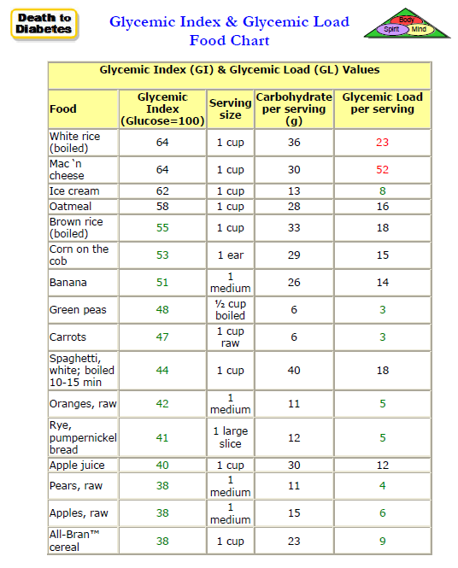
Nutrition therapy (cont’)

Slide 32
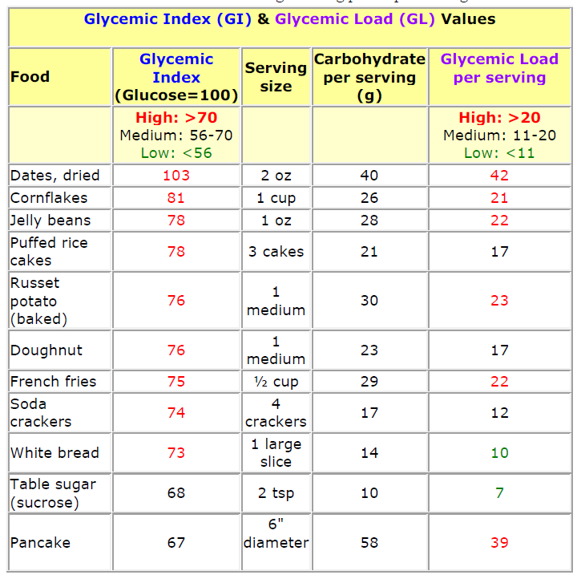
Nutrition therapy (cont’)

Slide 33
Nutrition Therapy (cont’)
10 Low-Glycemic Fruits for Diabetes
Cherries (GI:20, GL:6)
Grapefruit (GI:25, GL:3)
Dried apricot (GI:32, GL:9)
Pears (GI:38, GL:4)
Apples (GI: 39, GL:5)
Oranges (GI:40, GL: 5)
Plums (GI: 40, GL: 2)
Strawberries (GI:41, GL:3)
Peaches (GI: 42, GL: 5)
Grapes (GI: 53, GL: 5)

Slide 34
Nutrition Therapy (cont’) GI or GL? Though the GL of watermelon is low, be sure to balance any meals containing watermelon with low-GI foods to minimize any potential blood sugar spikes.
Watermelon GI: 72, GL: 2

Slide 35
Nutrition Therapy (cont’)
Choose complex CHO contain Fiber:
Soluble (legumes, oats, oat bran, barley, nuts, fruits)
Insoluble (whole grain breads, cereals and some vegetables, seeds)
Both:
Increase satiety
Slowing absorption time
Lower glycemic index
Reader,2007

Slide 36
Nutrition Therapy (cont’)
Carbohydrate Counting
Works as follows:
A dietitian determines a person’s dietary needs
The individual is given a daily CHO allowance
Divided into a pattern of meals & snacks
according to individual preferences
The carbohydrate allowance can be expressed in
grams or as the number of carbohydrate portions allowed per meals

Slide 37
Nutrition Therapy (cont’)
Carbohydrate Counting
Emphasis is given to spreading the dietary intake over six meals daily:
3 main meals
3 snacks
Distribution of CHO in daily meals
meals | Breakfast | Snack1 | Lunch | Snack2 | Dinner | Snack3
CHO% | 15% | 12.5% | 25% | 12.5% | 25% | 10%

Slide 38
Nutrition Therapy (cont’)

Slide 39
Nutrition Therapy (cont’)
Example: 35 year old woman diagnosed with GDM, at weeks 28 of her pregnancy,
Pre-pregnancy weight: 90, height 1.70, BMI: 31
The nutrition prescription is the following:
Calories: 2000
Carbohydrates (50%): 250 g
Protein (20%): 100 g
Fat (30%): 66 g
Meals | Breakfast | Snack1 | Lunch | Snack2 | Dinner | Snack3
CHO% | 15% | 12.5% | 25% | 12.5% | 25% | 10%
gram | 38 | 32 | 62 | 32 | 62 | 25

Slide 40
Nutrition Therapy (cont’)
Fat intake:
Less than 10 % SFA (animal fat contained in cuts of meat; dairy products, such as milk, butter and cheeses; and the skin of chicken, turkey, and other poultry)
Up to 10 % PUFA (are found in fish, soybean products, walnuts, and flaxseeds.)
The remainder derived from MUFA (are found in avocados, nuts, seeds, olive oil, canola oil, and peanut butter.)
Cheung,2009

Slide 41
Nutrition Therapy (cont’)
Protein intake:
Dietary proteins and amino acids are important modulators of glucose metabolism, and a diet high in protein may impact glucose homeostasis by promoting insulin resistance and increasing gluconeogenesis.
Most protein sources don’t have carbohydrates and won’t raise blood sugar, but be sure to check vegetarian sources of protein, such as beans and legumes, which can contain carbohydrates.
Cheung,2009

Slide 42
Nutrition Therapy (cont’)
Nutrient needs
There is no indication that women with GDM should not follow the same guidelines for nutrient intakes for all pregnant women
(Dietary Reference Intakes for pregnancy 2001)
Reader,2007

Slide 43
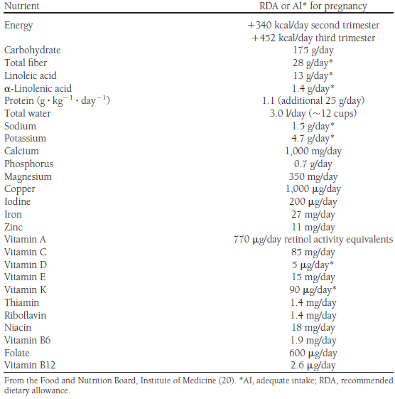
Nutrition therapy (con’t)

Slide 44
Exercise
Exercise is an obvious adjunct therapy to MNT for women with GDM to improve maternal glycemia.
light and moderate intensity activities such as walking for 20–30 min/day:
can be safely encouraged,
modest improvements in glycemic control might be achieved
Reader,2007

Slide 45
Recommendations
Breakfast Tips:
Eat a small breakfast.
Eat whole-grain bread products.
Eat a food that has protein. This will help you to: feel full, get enough protein for you and your baby, control your blood sugar.
Do not eat cereal or fruit.
Do not drink fruit juice at breakfast or any other time of the day. Fruit juice raises your blood glucose very quickly.

Slide 46
Recommendations
Fat Tips:
Fat contains calories to help supply energy to you and your baby. Fat helps your body absorb vitamins A, D, E and K. Fat also gives you essential fatty acids, which help your baby's brain and nervous system develop.
It is important to focus on eating healthful fats. The following foods are good sources of healthful fats:
Most nuts and seeds
Peanut butter (natural or trans fat-free)
Cooking oils (olive, canola, peanut or flaxseed)
Avocados
Fatty fish (salmon or trout)

Slide 47
Recommendations
Tips to remember:
If you are hungry, add vegetables or a protein food to your carbohydrate snacks.
Focus on eating healthful fats.
If your blood glucose is high when you wake up, have a bedtime snack that includes both protein and carbohydrates. This will help keep your blood glucose in check during the night.

Slide 48
CONCLUSIONS
Women with GDM (and women with preexisting diabetes) should be encouraged to breastfeed because breastfeeding is associated with a reduced incidence of future T2DM (Stuebe, 2005).
For women with GDM who are overweight or obese or with above-recommended weight gain during pregnancy, weight loss is advised after delivery.
Weight loss reduces the risks of recurrent GDM or future development of T2DM.

Slide 49
CONCLUSIONS
The food plan should be designed to:
Fulfill minimum nutrient requirements for pregnancy
Achieve glycemic goals without weight loss and ketonemia
Be culturally appropriate and individualized to take into account the patient’s body habitus, weight gain, and physical activity

