Slide 2
Urinary Incontinence

Slide 4
Epidemiology
The precise prevalence of urinary incontinence(UI) is difficult to estimate.
The prevalence of UI reported in the literature is varied.
UI has been estimated to affect 200 million people worldwide.
UI is underdiagnosed and underreported.
An estimated 50-70% of women with UI fail to seek medical evaluation and treatment because of social stigma.

Slide 5
Epidemiology
Only 5% of incontinent individuals in the community receive appropriate medical evaluation and treatment.
People with incontinence often live with this condition for 6-9 years before seeking medical therapy.
The cost of its treatment

Slide 6
Sex- and age-related patterns
Age is the single largest risk factor for UI, although at any age, UI is more than 2 times more common in females than in males.

Slide 7
An age-related pattern also appears in the predominant type of UI experienced. In general, studies have shown that SUI tends to be more common in women younger than 65 years, while UUI is more common in women older than 65 years.

Slide 8
SUI affects 15-60% of women-both young and old individuals.

Slide 9
Race-related factors
Differences in functional and anatomic morphology of the urinary sphincter mechanism in people of different races
Black women demonstrate a 29% higher average urethral closure pressure during a maximum pelvic muscle contraction.
UUI is more common in black women, whereas SUI is significantly more common in white women.

Slide 10
UI can result in prolonged hospital admission, UTIs, contact dermatitis, and falls.
UI is a leading cause of admission to a nursing home.

Slide 11
Signs and Symptoms

Slide 12
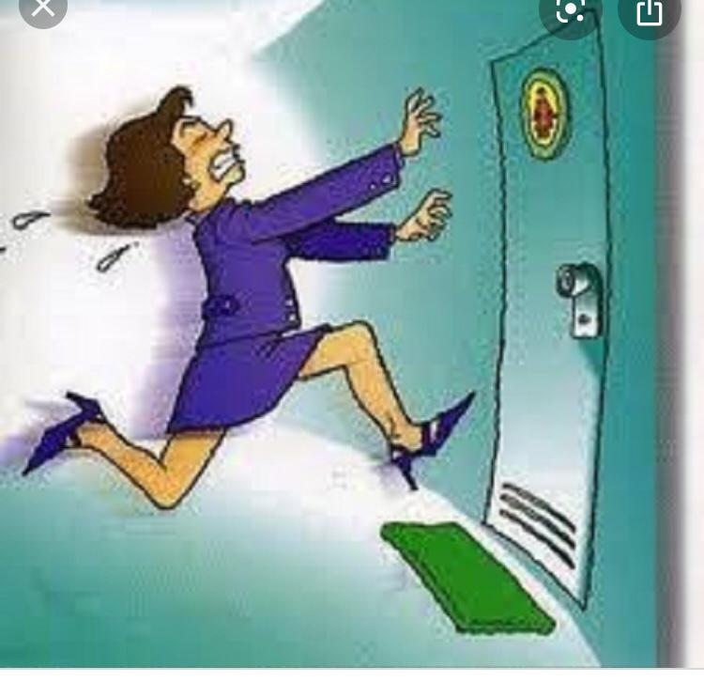

Slide 13
Types of urinary incontinence
Stress urinary incontinence
Urge urinary incontinence
Mixed urinary incontinence
Functional urinary incontinence
Overflow urinary incontinence
Continuous urinary incontinence

Slide 14
Transient urinary incontinence
Reflex urinary incontinence
Giggle urinary incontinence

Slide 15
Risk Factors:
Age
Sex (gender)
Obstetrical history
History of pelvic surgery
Spinal and CNS trauma and surgery
Lifestyle issues (smoking, alcohol or caffeine abuse)
Chronic cough
COPD
CHF
DM
Obesity

Slide 16
Risk Factors:
Connective tissue disorders
Postmenopausal hypoestrogenism
CNS or spinal cord disorders
Chronic UTIS
Cancers of pelvic organs
Urologic disorders (stones)
Medications (Alpha-blockers, allergy medications, Estrogen replacement, Beta-mimetics, sedative, Muscle relaxants, Diuretics, ACE inhibitors)
Family history

Slide 17
Functional contributors to incontinence:
DIAPPERS

Slide 18
Disease Management

Slide 20
Lifestyle intervention
Obesity
Smoking
Level of physical activity
Diet

Slide 21
Caffeine reduction

Slide 22
Physical exercise

Slide 23
Fluid intake

Slide 24
Obesity and weight loss

Slide 25
Smoking

Slide 27
“Behavioral and physical therapies”

Slide 28
Prompted voiding
Bladder training

Slide 29
Pelvic floor muscle training
Efficacy of PFMT in SUI, UUI and MUI in women
Efficacy of PFMT in childbearing women
PFMT in the elderly
PFMT in men

Slide 30
Electrical Stimulation

Slide 31
ES of the pelvic floor
Posterior tibial nerve stimulation
P-PTNS
T-PTNS

Slide 32
Electromagnetic stimulation
Pulsed EMS

Slide 33
Pharmacologic management of UI

Slide 35
Drugs for UUI
Antimuscarinic drugs
Beta agonists
Combination therapy

Slide 36
The elderly and cognition

Slide 37
Drugs for SUI
Duloxetine

Slide 38
Estrogen

Slide 39
Desmopressin

Slide 40
Drug treatment in MUI

Slide 41
Prevention

Slide 42
Maintain a healthy weight
Practice pelvic floor exercises
Avoid bladder irritants, such as caffeinated drinks, alcohol, and acidic foods
Eat more fiber which can prevent constipation
Don’t smoke

Slide 43
Thanks for your attention.

