Slide 1
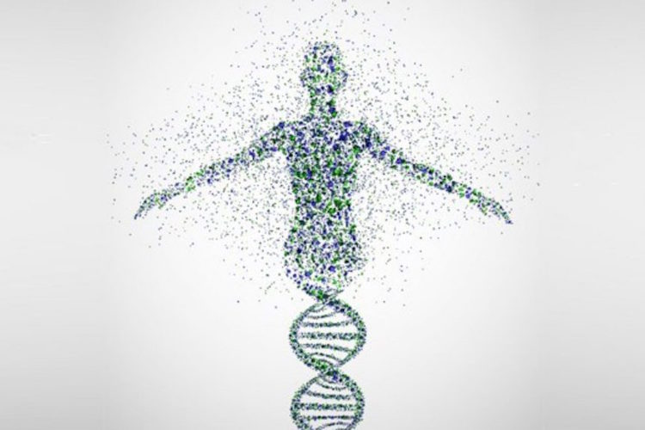
Your DNA
Is Not
Your Destiny

Slide 2
Central Dogma
Flow of genetic information in cell

Slide 3
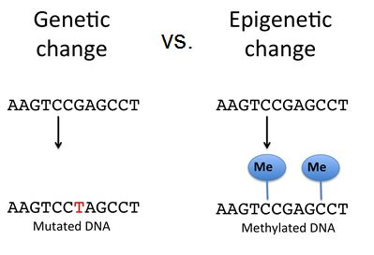
Genetics vs. Epigenetics

Slide 5
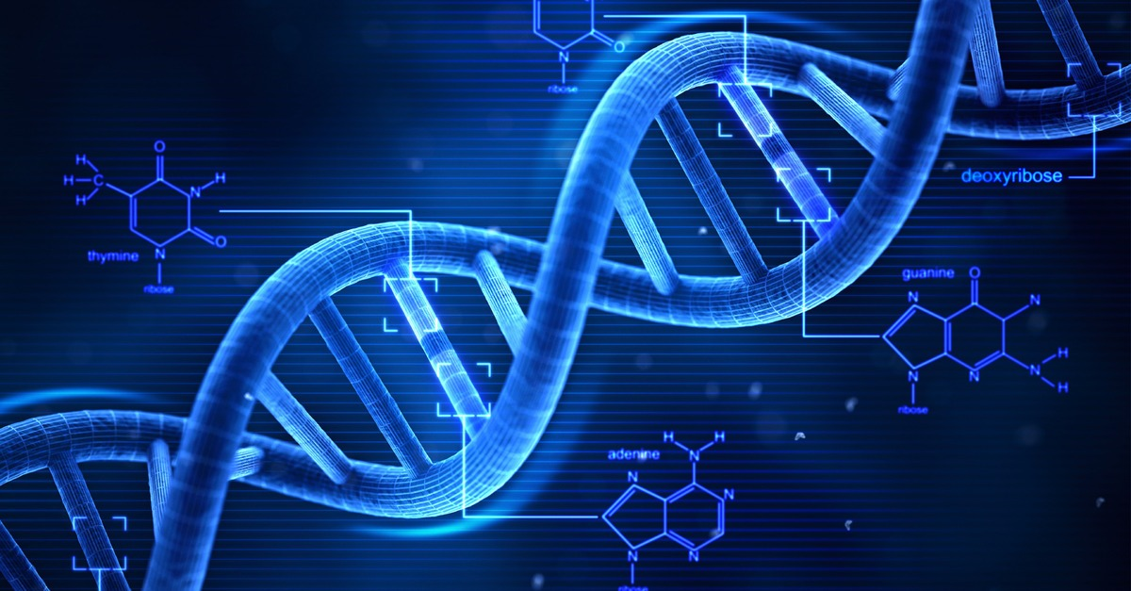
Humans 250 different cell types.
contain exact same DNA & same order
Initially a sigmoid cell & cell multiplied by mitosis, converted to a large number of cells are quite similar, grouped together, begins to create specific organs by silencing the gene Specifics.
liver or nerve cells look different& have different skills.
How they recognize that need to be categorized and what gene is active & what gene is silenced to create a specific organ? !!

Slide 6
What makes the difference is a process called epigenetics.
Epigenetic modifications create, patterns of active and inactive DNA for each cell type.
Epigenetic marks can also change throughout life in responses to environment or lifestyle.
For example, smoking changes the epigenetic makeup of lung cells, eventually leading to cancer.
Other influences of external stimuli like stress, disease or diet are also supposed to be stored in the epigenetic memory of cells.

Slide 7
Difference between epigenetic inheritance & inheritance?
classic genetic model, you get genes from your parents, they received from their parents and these genes remain the same - except in the rare cases of random mutations in the genome. In this model, inheritance is constant and unchanged.
But based on epigenetic inheritance, individual experiences can create molecular variations in the upstream of the genome, and this molecular change is transmitted to the next generation.
Epigenetic heredity is another layer of heredity that suggests one's experiences can change the way genes are used in later generations. This contradicts the knowledge of heredity since Darwin and Mandel.

Slide 8
Epigenetics
Gene expression changes not caused by changes in DNA sequence
Genes are “turned on” or “turned off” by chemical alterations to:
- DNA (e.g. methylation) or RNA
- histone modification (methylation, acetylation, etc.)
Epigenetic changes can be heritable
If DNA (genome) is the hardware of a computer,
epigenetics (epigenome) is like the “software”.
Provides an additional layer of information on the genetic info.

Slide 9
Epigenetics
heritable changes in gene expression (active versus inactive genes) change in phenotype without a change in genotype.
Epigenetic change is a regular and natural occurrence can influenced by several factors including age, the environment/lifestyle, and disease state.
Epigenetic modifications can manifest commonly in which cells terminally differentiate to end up as skin cells, liver cells, brain cells, etc.
Or
Epigenetic change can have more damaging effects that can result in diseases like cancer.

Slide 10
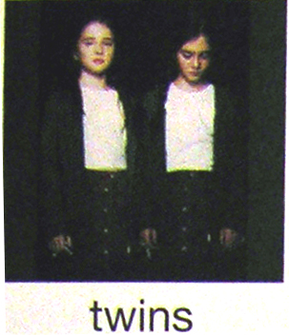
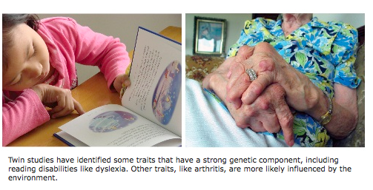
Examples of Epigenetic Phenomena
Monozygotic:
Genomes are identical
Notes:
Part of Figure 1 p. 26

Slide 11
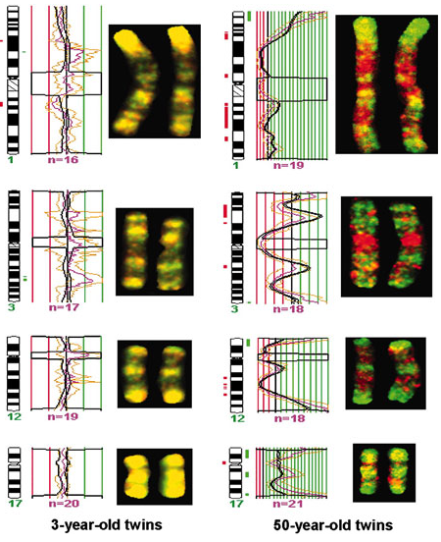
Differences in the epigenome of monozygotic twins
Fraga et al. PNAS, 2005

Slide 12
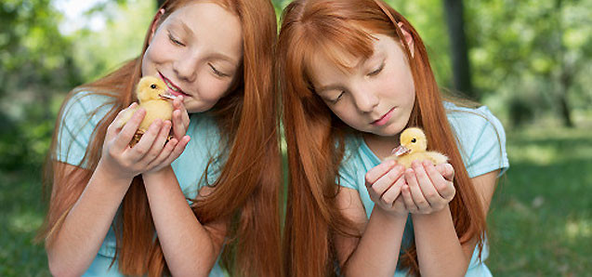
Identical Twins with Different Hair Color
Identical Twins with Different Behavior(Action)

Slide 13
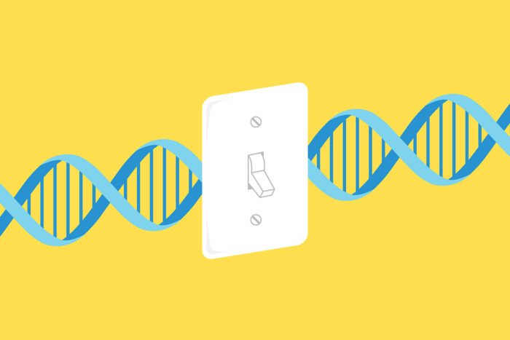
We Are More Than
The sum Of
Our Genes
Epigenetic mechanisms modulated by environmental cues such as diet, disease or lifestyle major role in regulating the DNA by switching genes On and Off.
not only inherited DNA but also, inherited epigenetic instructions contribute in regulating gene expression in the offspring.

Slide 14
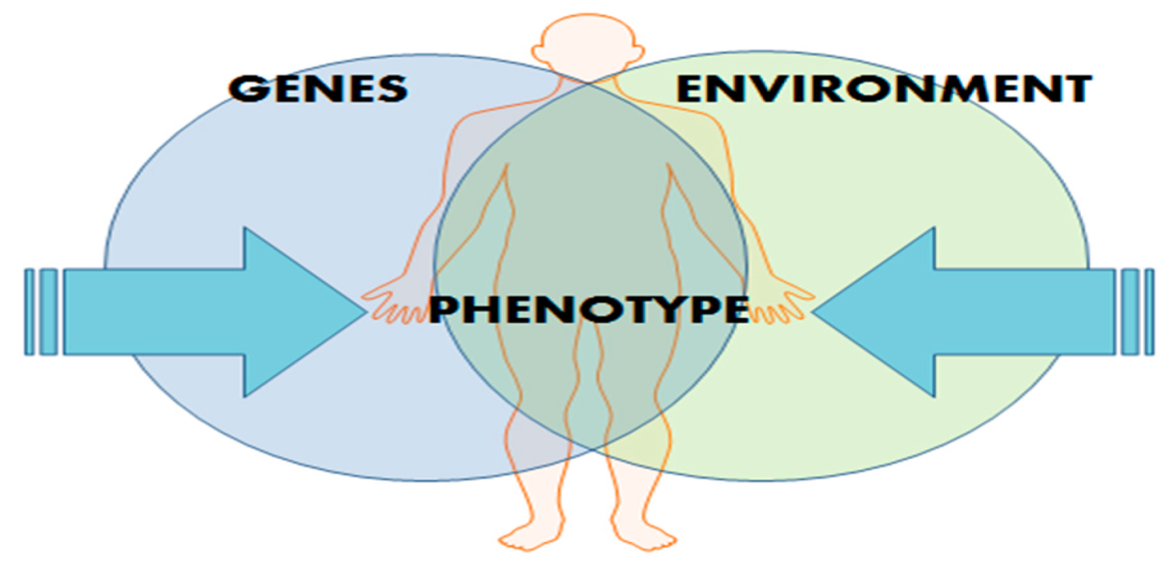
If epigenetic modifications accumulated entire life can cross of generations & inherited to children or even grand children?

Slide 15
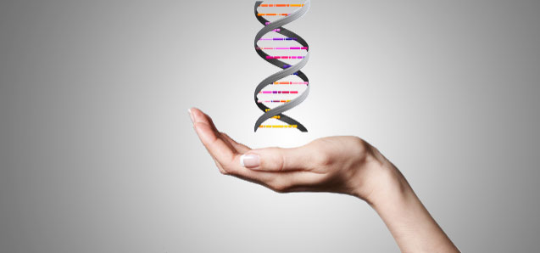
Epigenetics is a theory of inheritance that says genes have a "memory" for events.
For example, two generations may be exposed to an event, &event occurs in the genes ‘ genetic imprinting; & same pattern will continue for 4 or 5 generations or more, thus, in fact, the pattern of gene expression change , without changing the DNA sequence.

Slide 16
For most genes, inherit two working copies -- one from mom and one from dad.
But with imprinted genes, inherit only one working copy.
Silencing usually happens through the addition of methyl groups during egg or sperm formation.

Slide 17
The epigenetic tags on imprinted genes usually stay put for the life. But they reset during egg and sperm formation.
whether they came from mom or dad, certain genes are always silenced in the egg, and others are always silenced in the sperm.

Slide 18
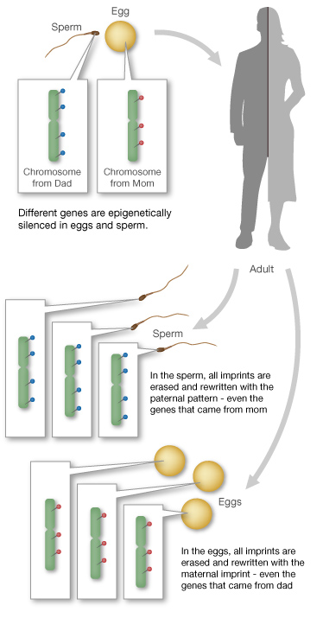

Slide 19
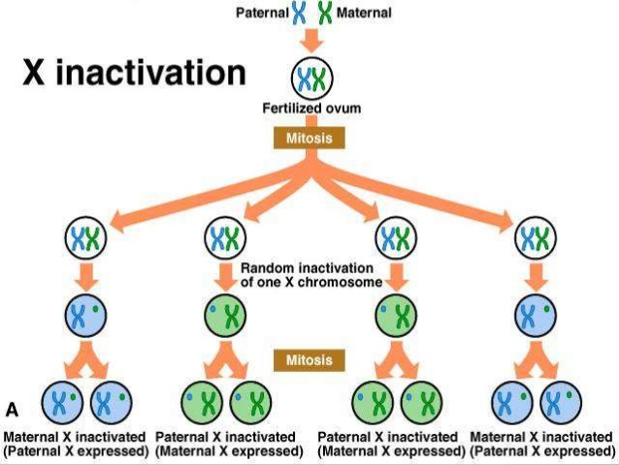
Natural Mechanism

Slide 20
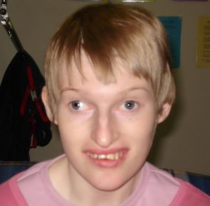
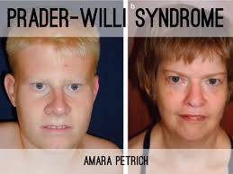
Invalid Performance of epigenesis
Angelman syndrome

Slide 22
Epigenetics between the generations Researchers
Particular modification H3K27me3 that can also be found in humans.
H3K27me3 modifications labeling chromatin DNA in the mother’s egg cells were still present in the embryo after fertilization, even though other epigenetic marks are erased.

Slide 23
Epigenetics between the generations Researchers
“This indicates that the mother passes on her epigenetic marks to her offspring.
were also interested, if those marks are doing something important in the embryo.
Inherited epigenetic marks are important for embryogenesis

Slide 24
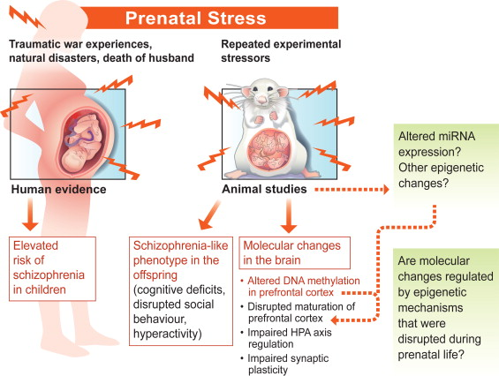
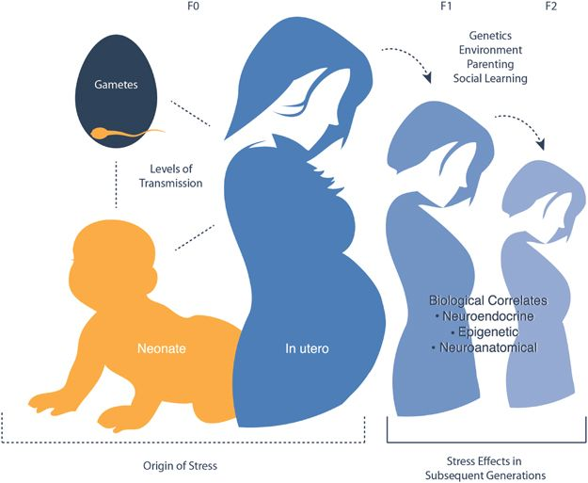
Dr. Jonathan University of Edinburgh is a clinical expert on the cortisol stress hormone.
If pregnant laboratory rats are stressed, their next generation will show signs of stress, high blood pressure, diabetes and anxiety behaviors.
This is an example of a "native effect" that affects the environment of the uterus of subsequent generations.

Slide 25
In humans, the abuse of children is associated with epigenetic changes.
There can be a reasonable link between different diseases such as cancer, diabetes and schizophrenia with epigenetic indicators.

Slide 27
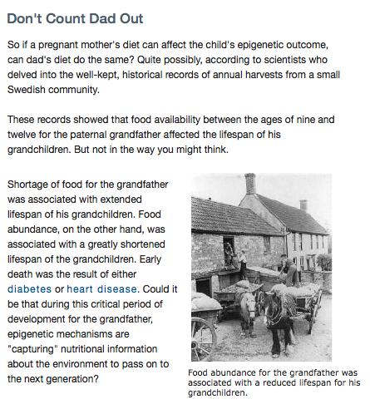
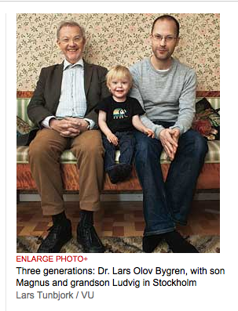
Human transgenerational epigenetic phenomena?

Slide 28
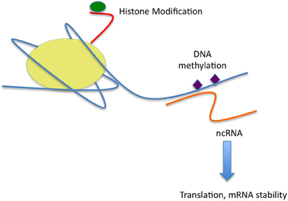
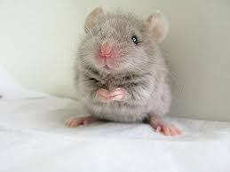
How are experiences inherited?
Mice inherit memories of Fear from their Grandparents

Slide 29
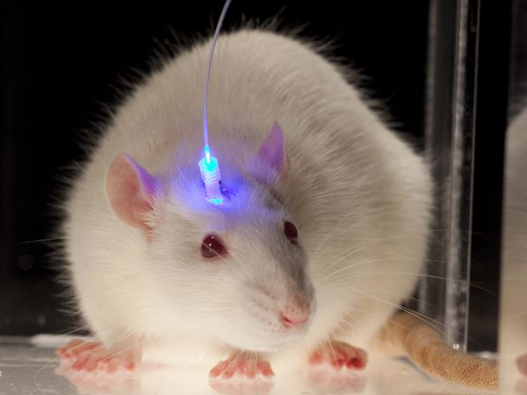
Important and practical findings of epigenetic research
Memories of fear are inherited. Researchers trained male rats to interact with specific scars and electrical shocks, were scared to smell it.
frightens the scenes of the next two generations. This behavior was even seen in IVFs (in which the next generation was not taught by their parents).

Slide 30
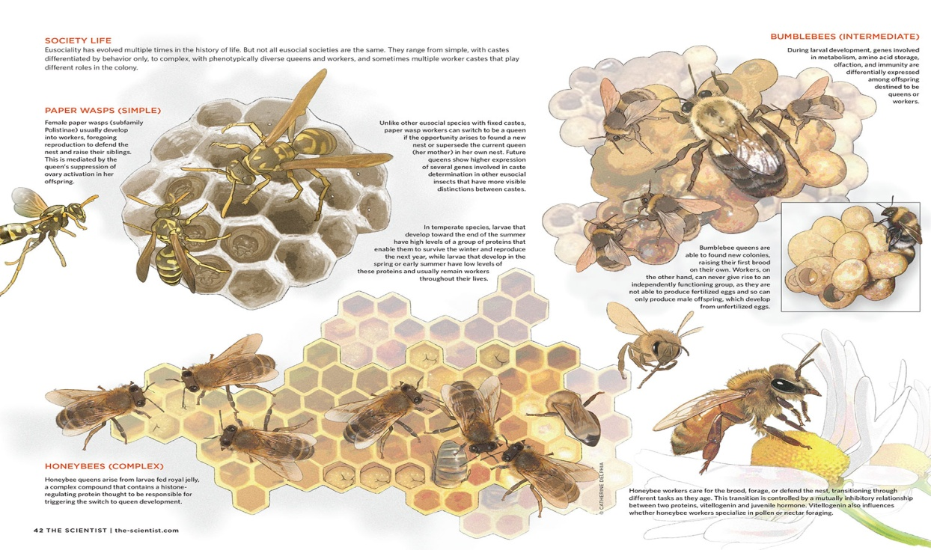
Epigenome plays a role in silencing genes
Influence of external environment on chemical index
The difference between a queen and a worker in honey bees is not in their DNA sequence.
Larvae become queens fed to the Royal Jelly.
Royal jelly contains compounds that interfere with genes regulation

Slide 31
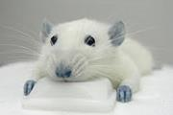
Important and practical findings of epigenetic research
Male rats with low-folate diet have different epigenetic parameters in their sperm DNA, and their births have more deficits at birth.

Slide 32
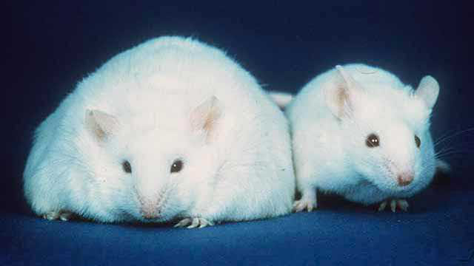
Important and practical findings of epigenetic research
Mice were placed under hunger during their pregnancy, rise to weightless births and metabolic problems, their grandchildren also had metabolic problems. Their boys had different epigenetic parameters in their sperm DNA, indicating how grandparents inherited health problems.

Slide 33
Important and practical findings of epigenetic research
Male rats with low-folate diet have different epigenetic parameters in their sperm DNA, and their births have more deficits at birth.
Mice were placed under hunger during their pregnancy, rise to weightless births and metabolic problems, their grandchildren also had metabolic problems. Their boys had different epigenetic parameters in their sperm DNA, indicating how grandparents inherited health problems.
Memories of fear are inherited. Researchers trained male rats to interact with specific scars and electrical shocks, so they were scared to smell it. scientists have shown that it also frightens the scenes of the next two generations. This behavior was even seen in IVFs (in which the next generation was not taught by their parents).

Slide 34
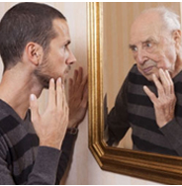
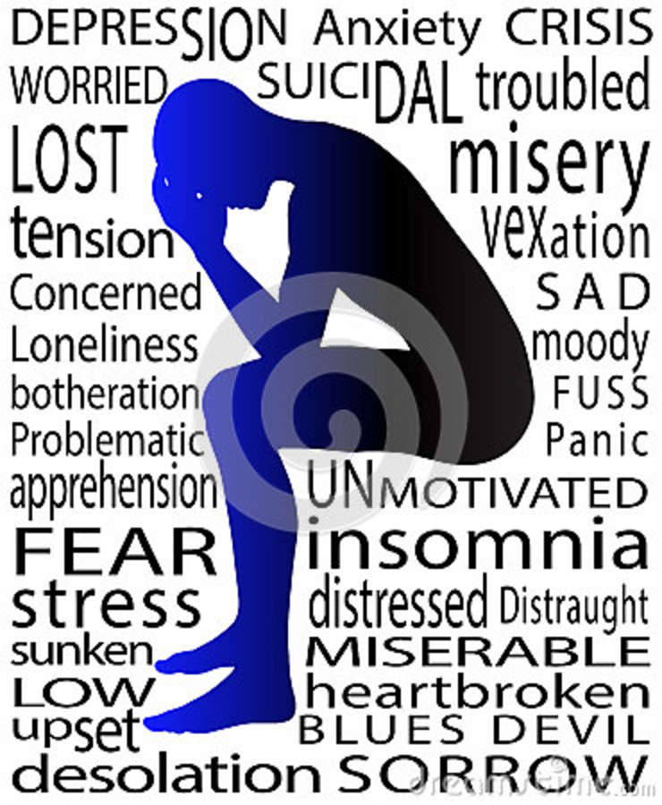
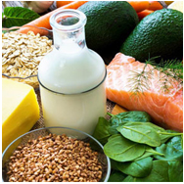
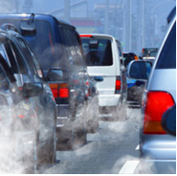
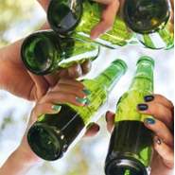
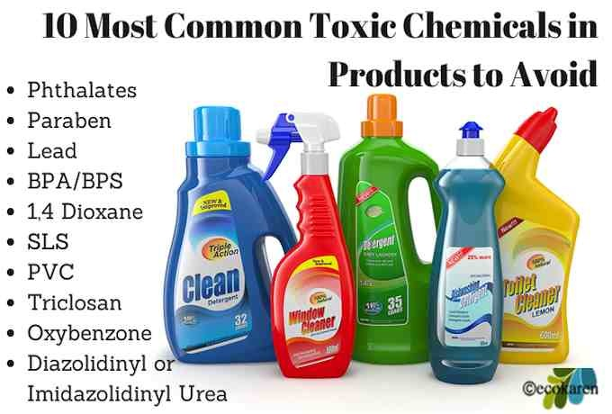
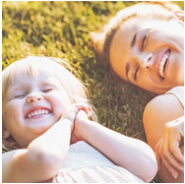
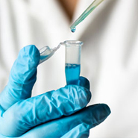
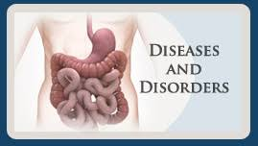
Aging
Diet
Psychological state
Exercise
Social Interaction
Environment
Drugs & Addiction
Technical
Toxic Chemical
Parenting

Slide 35
Epigenetic

Slide 37
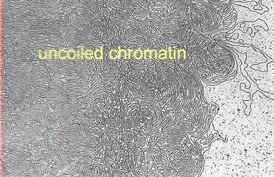
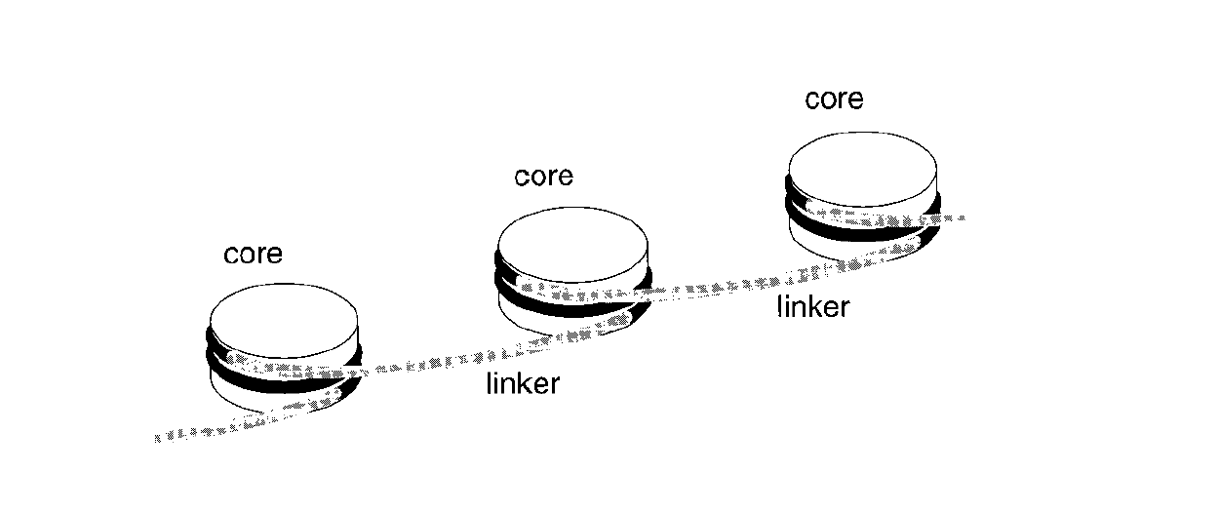
Nucleosome

Slide 38
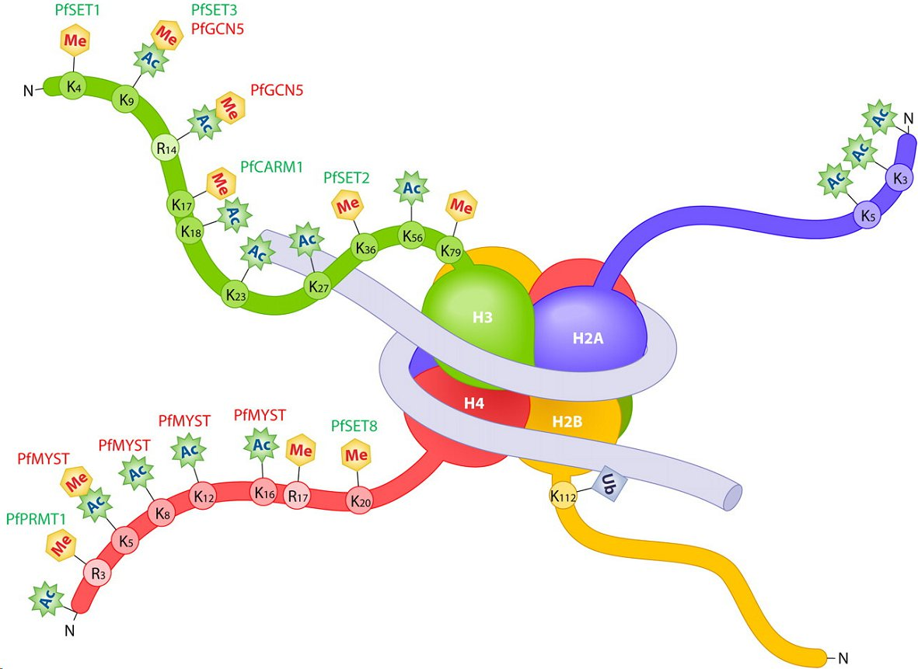
The “histone code” regulates gene expression
Activating: e.g. H3K4me3
Silencing: e.g. H3K9me3, H3K27me3

Slide 39
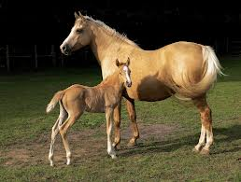
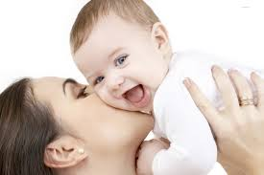
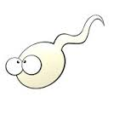
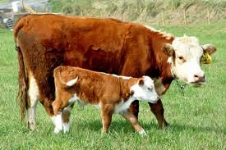
Reproduction
Genetics
+
=
Epigenetics
Environment

Slide 41
Methylation Changes During Development
Paula Vertino, Henry Stewart Talks

Slide 42
Methylation Changes During Development
Paula Vertino, Henry Stewart Talks

Slide 43
Methylation Changes During Development
Paula Vertino, Henry Stewart Talks

Slide 44
Rationale:
15% of couples fertility problems
50% of these: male factor – nonobstructive: 70% idiopathic infert.
reduced fertilization capacity of sperm
reduced embryonal survival/miscarriage
Chromatin integrity and proper nucleoprotein composition are prerequisites for normal sperm cell function.
Spermatogenesis
Molecular mechanisms of sperm DNA remodeling not well understood
Compromised sperm nucleoprotein composition =
increased ratio of nuclear histones to protamines (normal histone contents: 1-5% in mice, 5-15% in humans)
Incomplete chromatin condensation & persisting DNA strand breaks

Slide 45
Spermatogenesis
Rationale:
15% of couples fertility problems
50% of these: male factor – nonobstructive: 70% idiopathic infert.
reduced fertilization capacity of sperm
reduced embryonal survival/miscarriage
Chromatin integrity and proper nucleoprotein composition are prerequisites for normal sperm cell function.
Incomplete chromatin condensation & persisting DNA strand breaks
Compromised sperm nucleoprotein composition =
increased ratio of nuclear histones to protamines (normal histone contents: 1-5% in mice, 5-15% in humans)
Molecular mechanisms of sperm DNA remodeling not well understood

Slide 46
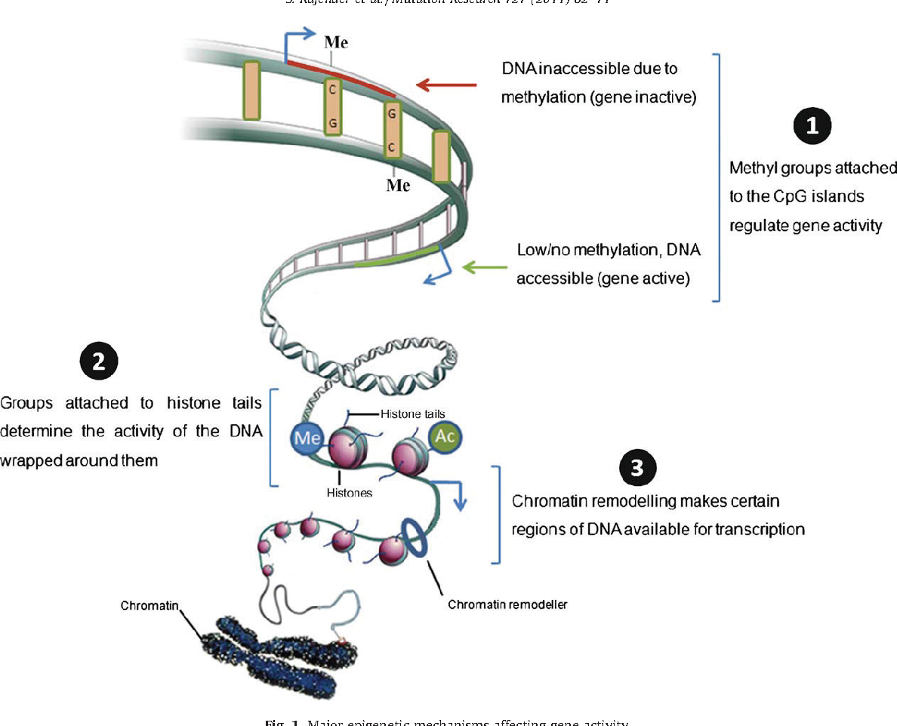

Slide 48
In general, this process activates or suppresses the expression of genes, whose proper functioning plays a part in the process of development and maturity of the gametes.
The interesting spermatogenesis: chromatin is re-packaged, 85 % of histones are replaced with protamine
& entering Protamins to the chromatin of sperm stimulate DNA compression.
This process is very important for spermatogenesis.

Slide 49
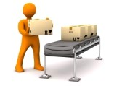
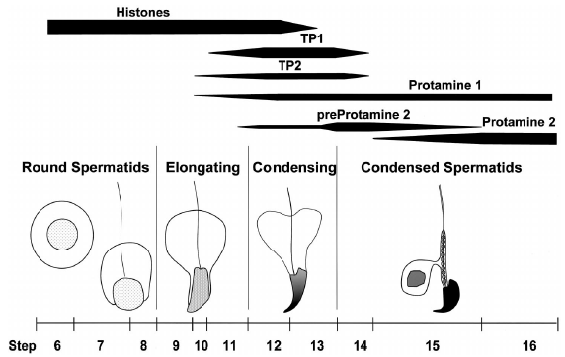
Chromatin remodeling in spermatogenesis
“Spermatogenesis”: postmitotic phase of male germ cell development
PAR
(after Zhao et al., 2004 )
Notes:
Focus attention on chromatin remodeling steps 9-14
Exchange of histones with TPs and protamines
Also massive amounts of transient and physiological DNA strand breaks to accommodate required changes in DNA topology
Also formation of poly(ADP-ribose)
The spermatid chromatin remodeling steps that we want to focus our attention on occur during steps 9 to 14 of mouse spermiogenesis. They are characterized by an drastic alteration of nucleoprotein composition due to replacement of the majority of histones by transition proteins, and subsequently protamines. These spermatids also contain massive amounts of physiological and transient DNA strand breaks. Those are required to relax the supercoiled DNA as it is would around histones and allow it to bind to protamines and form toroid shape structures. The spermatids also contain elevated levels of poly(ADP-ribose).

Slide 50
epigenetic mechanism, several changes associated with infertility
Male Infertility Methylation Changes
MTHFR, SFN, LIT1, NTF3, PAX8
Changes in histone associated with male infertility:
The study on mice shows a vital role of Jhmd2a( histone demethylase) in process of Spermatogenesis.
In regulating expression of two genes called Prm1 & Tnp1.
these genes are involved in the correct packaging of chromatin in the sperm.

Slide 51
epigenetic mechanism, several changes associated with infertility
Relationship between Chromatin Changes and Male Infertility:
Protamine before connecting to DNA is phosphorylated, At the same time, again dephospho.
The mutation in this protein causes a defective spermatogenesis & infertility in men.
Since protamine type 1 and type 2 are critical for sperm function, uncorrect mode for this genes make the chromatin structure unnatural and damage the DNA & these events cause infertility.

Slide 54
Implications for the theory of heredity and human health
We inherit more than just genes from our parents.
We also get important gene regulation machinery that influenced by environment and individual lifestyle.
Acquired environmental adaptations can be passed over the germ line to our offspring.
Since the disruption of epigenetic mechanisms may cause diseases such as cancer, diabetes and autoimmune disorders, these new findings could have implications for human health.

Slide 55
Epigenetic molecular tags are reversible.
Like DNA, they are not a steady form of inheritance.
Maybe you get some molecular labels, but put them in better labels throughout your life.
Sometimes behavioral changes or medications may also be used to restore unwanted epigenetic changes.
As a result, scientists are likely to remove harmful epigenetic indices from DNA individuals (epidrug).

Slide 56
سپاس از توجه تان

